Slide 1

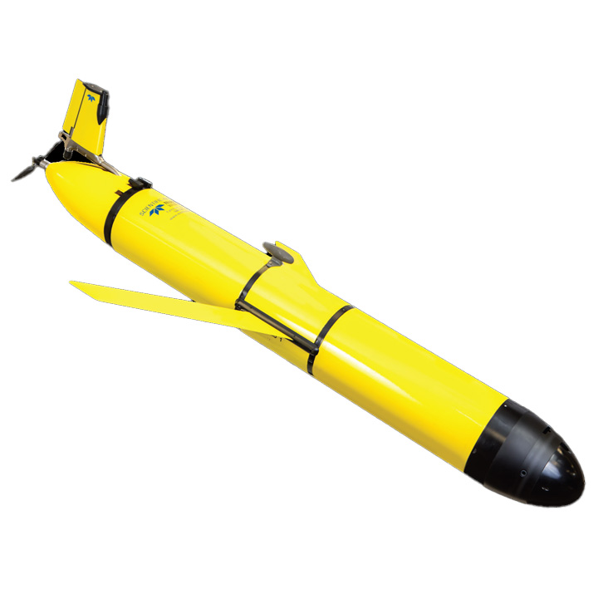
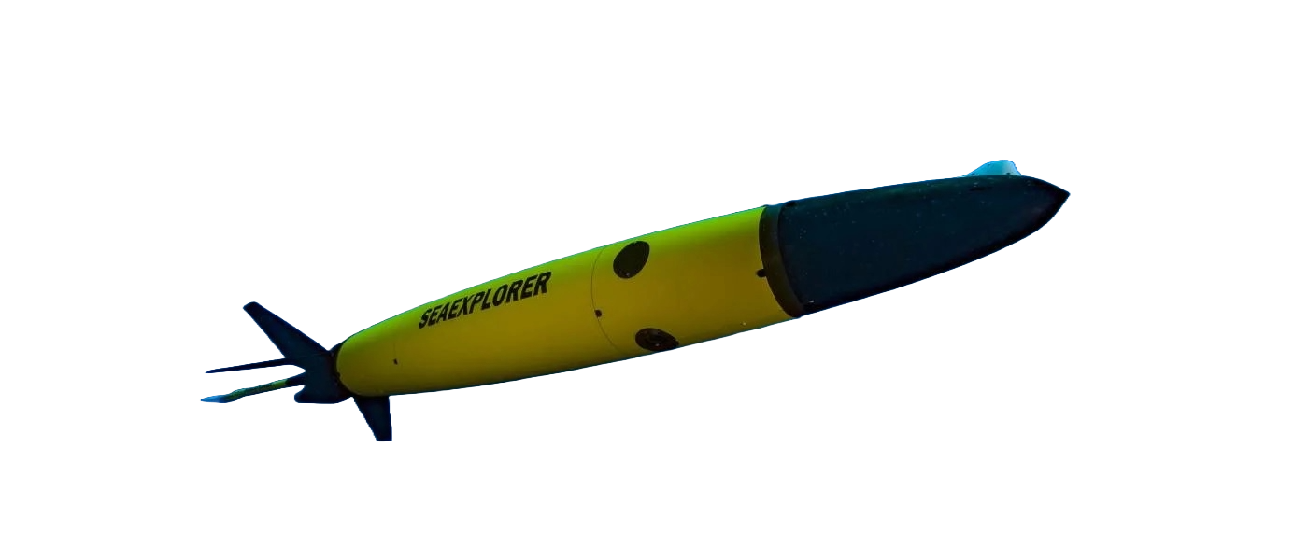
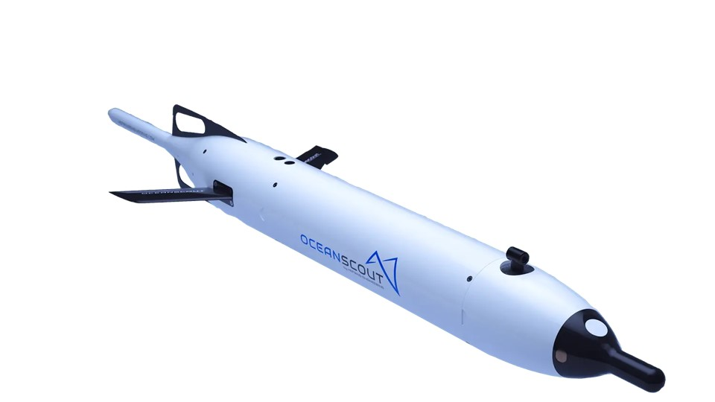
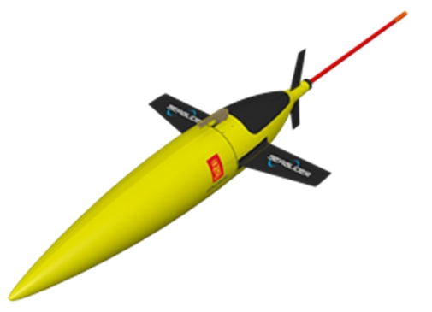
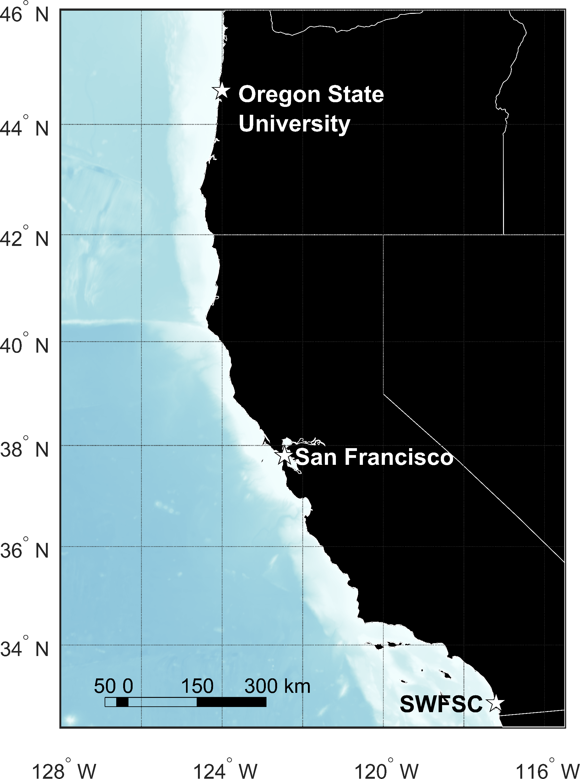
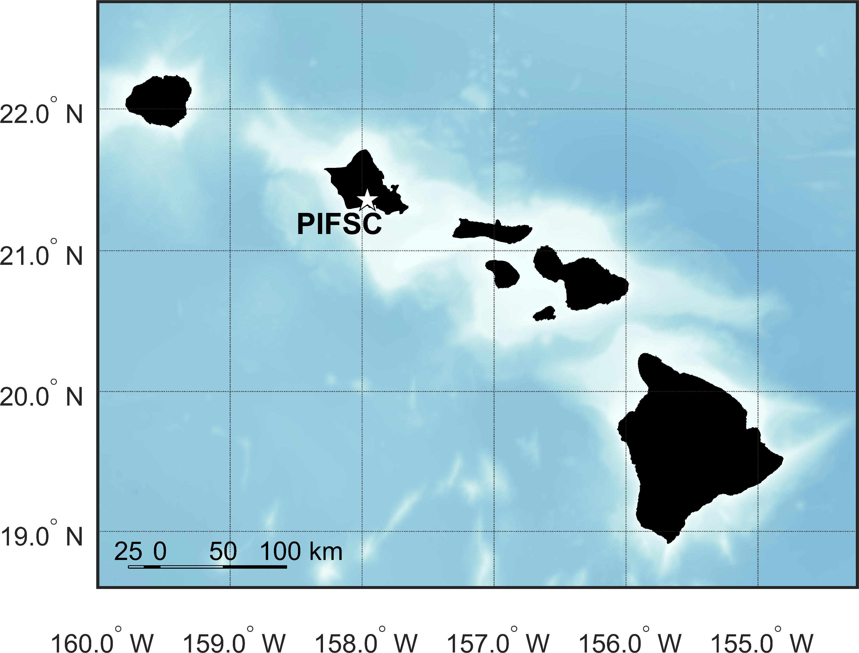



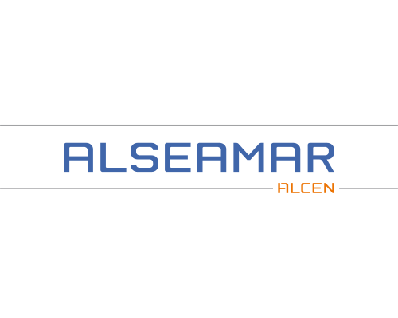
The PAM-Glider Rodeo
Passive Acoustic Monitoring (PAM) Glider Comparison
Erik Norris¹, Shannon Rankin², Erin Oleson¹, Christian Reiss², Selene Fregosi³, David K. Mellinger⁴
Testing 4 different gliders:
Seaglider
Slocum
SeaExplorer
OceanScout
Come fly with us!
Talk to us if you want to:
Testing 3 integrated PAM systems:
DMON
WISPR
Alseamar Acoustic Acquisition System
Field test PAM gliders
Field test other PAM systems
Analyze rodeo data
Discuss metrics to consider and compare
MAP OF CALIFORNIA
West Coast Rodeo
Anticipated dates:
two weeks each, late 2025 to mid 2026
US West Coast
Hawaii Rodeo
Main Hawaiian
Islands
For more info visit:
https://nmfs-pam-glider.github.io/GliderRodeo
Participants:
Southwest Fisheries Science Center (SWFSC)
Pacific Islands Fisheries Science Center (PIFSC)
1 NOAA Fisheries, Pacific Islands Fisheries Science Center
2 NOAA Fisheries, Southwest Fisheries Science Center
3 Ocean Associates, Inc. contracted to NOAA PIFSC
4 Cooperative Institute for Marine Ecosystem and Resources Studies, Oregon State University and NOAA Pacific Marine Environmental Laboratory

